Slide 1
Wastewater Aeration Control
DQN vs PER-DQN | Results, SHAP and rule extraction | Seed 42
An illustrative simulated aeration-tank environment
Four-controller interactive comparison + held-out evaluation
Explainability: SHAP Q-values and decision-tree surrogate

Slide 2
Two distinct evaluation settings
Do not combine metrics from different evaluation protocols
INTERACTIVE 24-HOUR RUNS
Manual, Auto DO, DQN, PER-DQN — one exported trajectory per controller.
HELD-OUT DRY TEST
Fixed 50%, Fixed 75%, rule-based, DQN and PER-DQN — 20 episodes each.
Weather event windows are diagnostic, not independent held-out tests.

Slide 3
Interactive 24-hour comparison
One simulated episode per controller; higher reward is better
Controller Reward DO < 2 Energy proxy Switches
Manual −197.22 68.75% 24.00 0
Auto DO −75.81 5.21% 38.81 20
DQN −69.56 15.63% 33.31 33
PER-DQN −71.85 26.04% 34.00 45
DQN leads on reward; Auto DO best prevents low DO.

Slide 4
Held-out dry test
20 episodes; models trained on dry data
Controller Mean reward DO < 2 Energy proxy
Fixed 50% −95.90 23.80% 24.00
Rule-based −65.20 3.80% 26.75
DQN −61.46 13.70% 23.23
PER-DQN −62.70 11.46% 24.20
DQN has the highest reward; rule-based minimizes low-DO time.

Slide 5
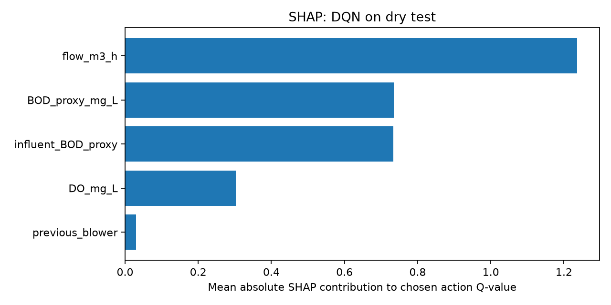
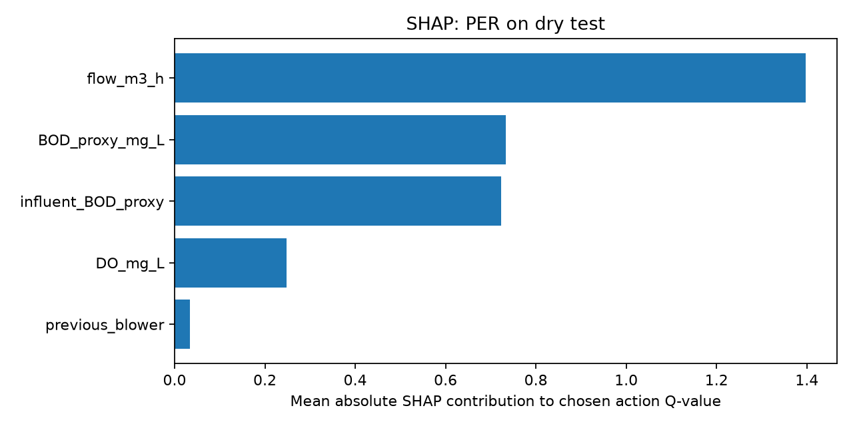
SHAP: selected-action Q-value
Mean absolute SHAP magnitude; larger means more impact on predicted Q-value
Both models rank influent flow highest; previous blower setting lowest.

Slide 6
Decision-tree surrogate fidelity
Tree is an approximation of the learned policy, not a safety controller
Metric DQN PER-DQN
Overall fidelity 85.24% 93.49%
Majority-action baseline 82.38% 89.84%
Balanced fidelity 56.87% 61.76%
Overall fidelity is inflated by class imbalance. Balanced fidelity reveals weaker accuracy across less-common actions.

Slide 7
Interpretable policy examples
Extracted from PER-DQN surrogate rules
IF tank BOD proxy > 168.60 AND DO ≤ 2.47
THEN action 3 → blower 75%.
IF tank BOD proxy ≤ 168.60 AND DO > 3.14 AND influent BOD proxy ≤ 94.67
THEN action 0 → blower 0%.
These thresholds describe model behavior in simulation; they are not validated operational rules.

Slide 8
Conclusions and limitations
• DQN outperformed PER-DQN on reward in the observed dry tests and interactive run.
• Rule-based / Auto DO control better protected against low dissolved oxygen.
• PER-DQN had higher surrogate fidelity, but this does not establish better control.
• Energy is a normalized proxy, not measured kWh. BOD is a model proxy.
• Next: train seeds 42, 43, 44; compare mean ± standard deviation and safety violations.

